Slide 1
CNN ARCHITECTURES FOR DETECTION AND SEGMENTATION
John R Ballesteros
PhD
Profesor
Universidad Nacional de Colombia

Slide 2
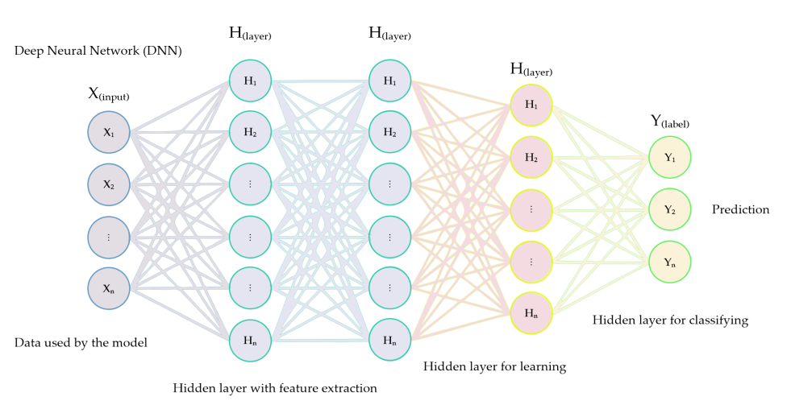

Slide 3
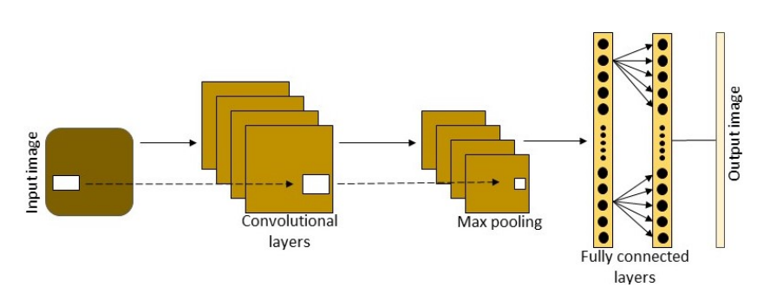

Slide 4
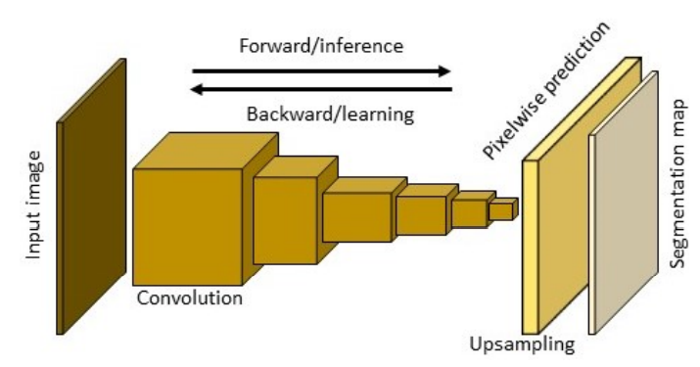

Slide 5
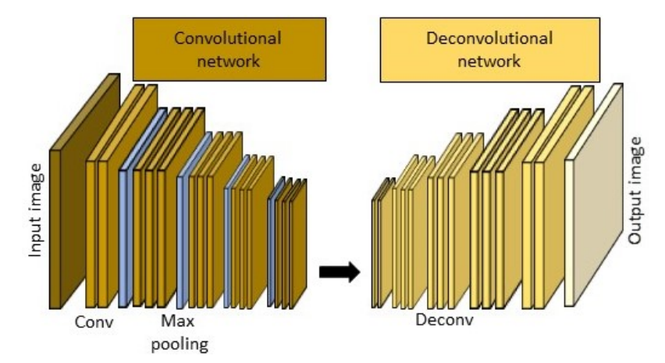
Abdollahi et al. Deep Learning Approaches Applied to Remote Sensing Datasets for Road Extraction: A State-Of-The-Art Review. 2020

Slide 6
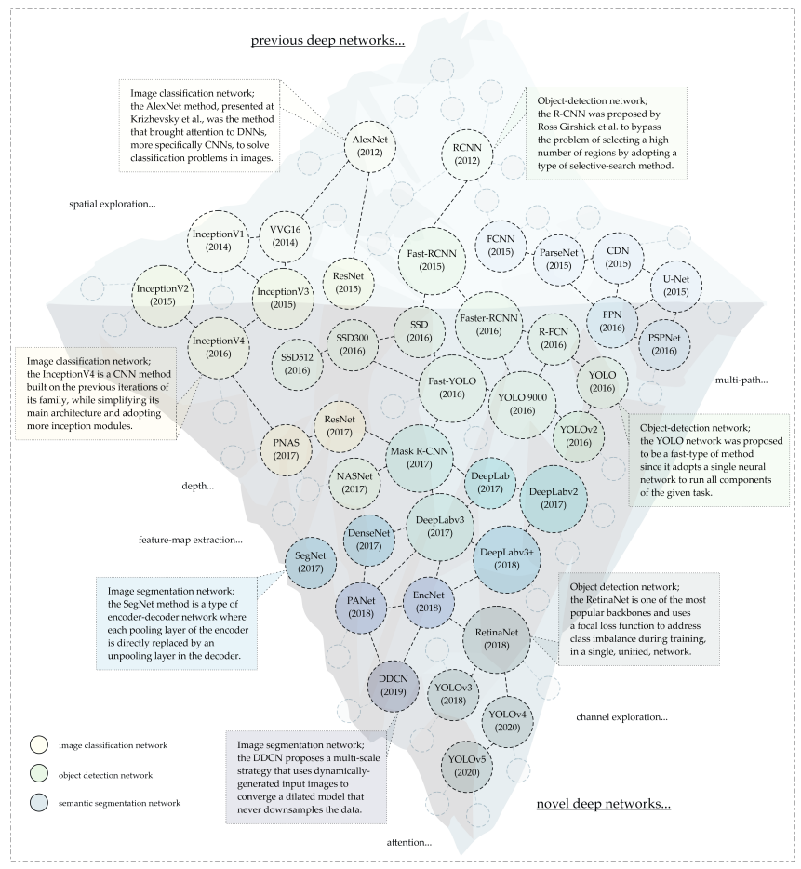
Osco et al, 2021

Slide 7
